Slide 1

SyR-e: an Open-Souce Tool for Electrical Machines Design
Simone Ferrari
simone.ferrari@polito.it
Dept. of Energy "Galileo Ferraris" – Politecnico di Torino

Slide 2
Content
What is SyR-e?
SyR-e features
Preliminary Automatic Design
Design Optimization
FEA Evaluation/Validation
Case Study

Slide 3

What is SyR-e?
SyR-e (Synchronous Reluctance – evolution) is an open-source (*) tool for SyR, PM-SyR and SPM machine design
Born in 2009 from a collaboration between Politecnico di Torino and Politecnico di Bari, for:
Investigate SyR geometries with no prejudice of the existing literature
Provide an automatic design tool for non-expert designers
In the latest versions, also PM machines are included, as PM-assisted SyR machines, SPM and IPM machines
Runs in Matlab/Octave
Uses FEMM for the FEA evaluations
Graphical User Interface helps to facilitate the design process and the user experience
(*) LICENSE: The C++ programs based on the original FEMM source code are licensed under the Aladdin Free Public License, as the original FEMM source is also provided under this license. The Matlab/Octave code is provided under the Apache Version 2.0 license. Further details and the texts of these licenses are provided with the source.

Slide 4
Content
What is SyR-e?
SyR-e features
Preliminary Automatic Design
Design Optimization
FEA Evaluation/Validation
Case Study

Slide 5
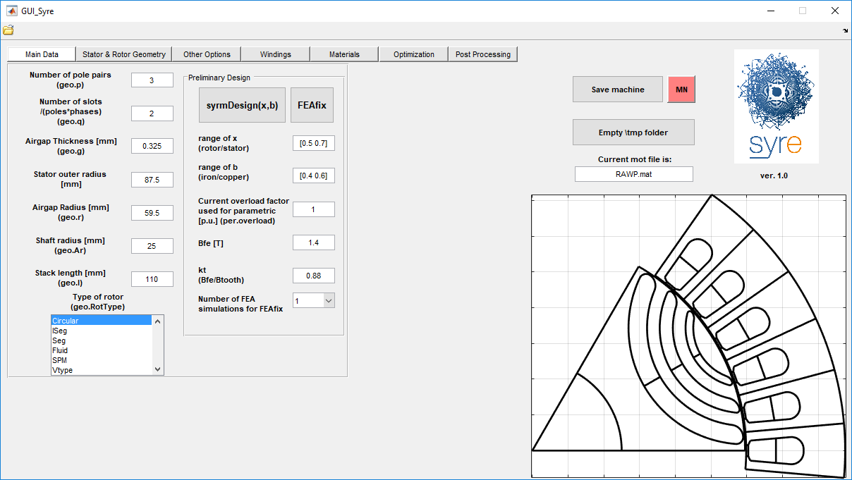
SyR-e sections
Design Optimization
FEA Evaluation/Validation
Manual input of the machine data
Automatic preliminary design
Main machine parameters

Slide 6
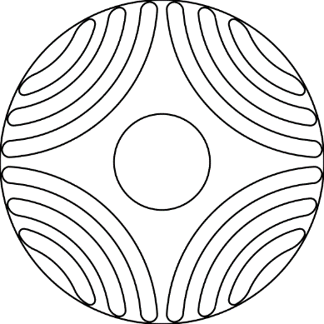
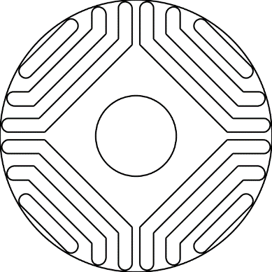
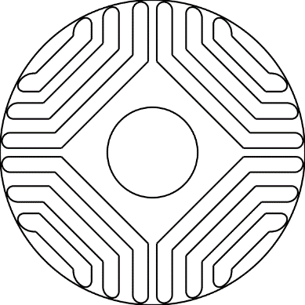
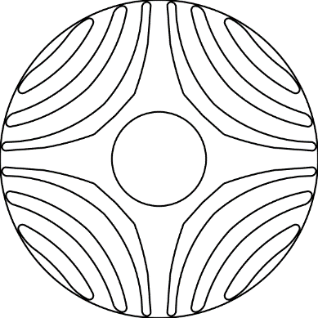
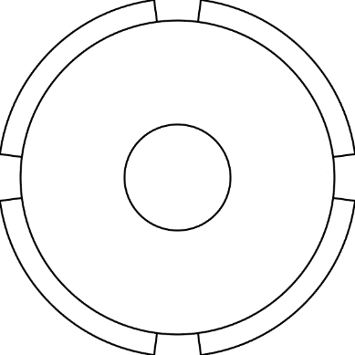
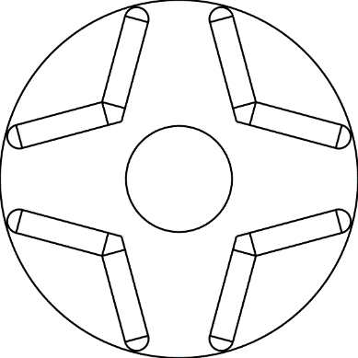
Main inputs and rotor geometries
Circular
Iseg
Seg
Fluid
SPM
Vtype

Slide 7
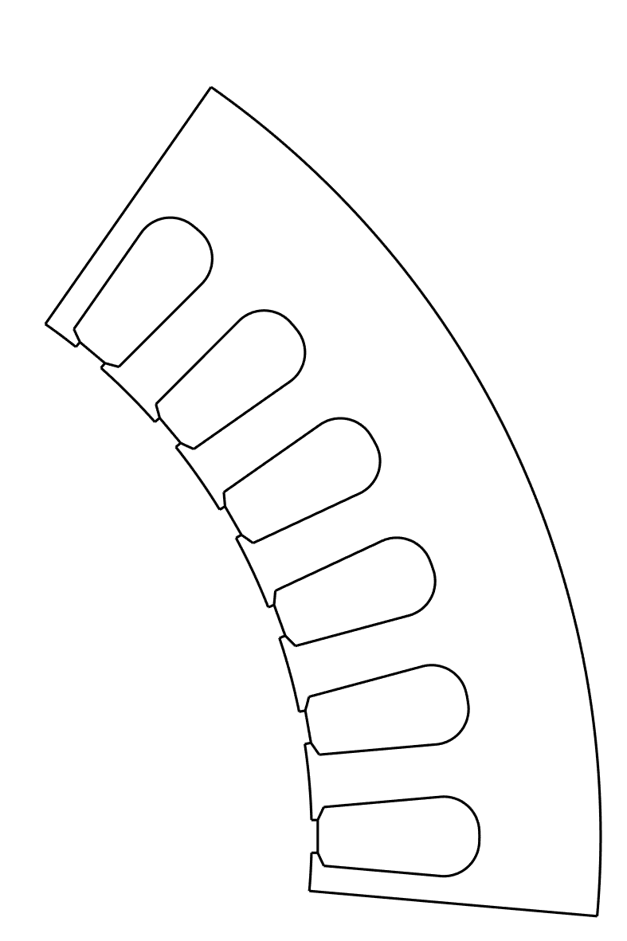
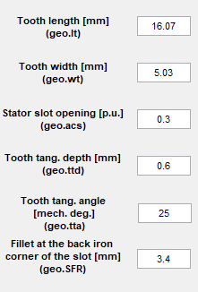
Stator Parameter

Slide 8

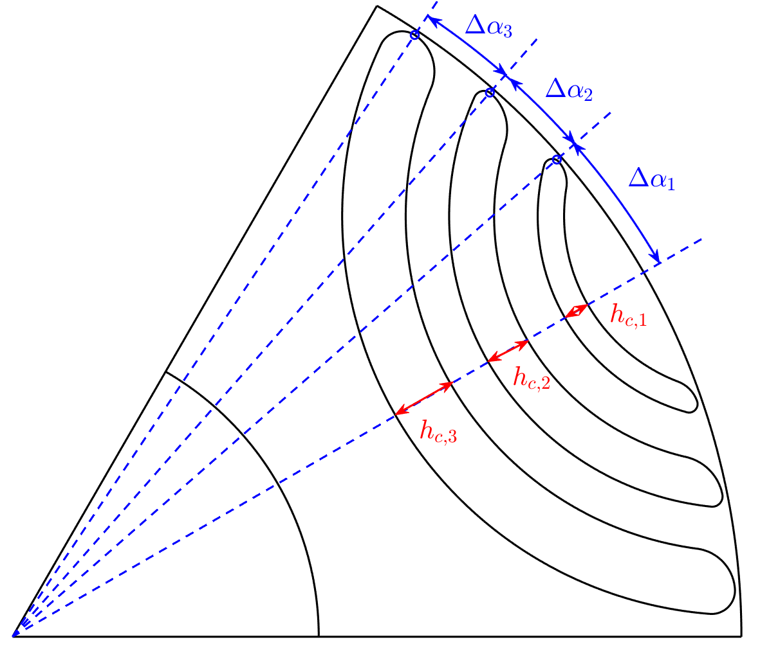
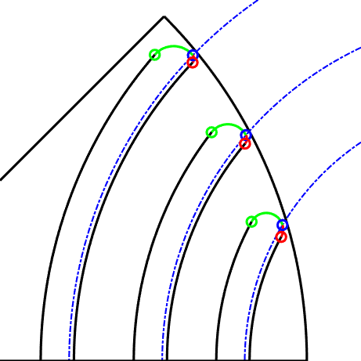
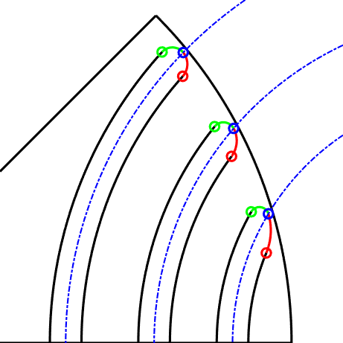
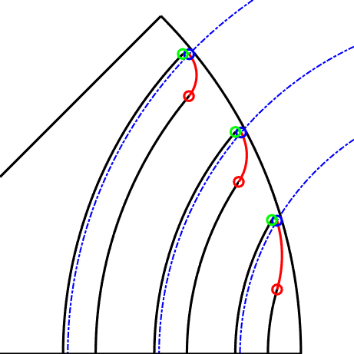
Rotor Parameter – SyR and PM-SyR
dx=[-1 -1 -1]
dx=[0 0 0]
PMs amount in the flux barriers [pu] (Circular only)
dx=[+1 +1 +1]
Flux Barrier Shift (Circular and Seg)
Structural ribs

Slide 9
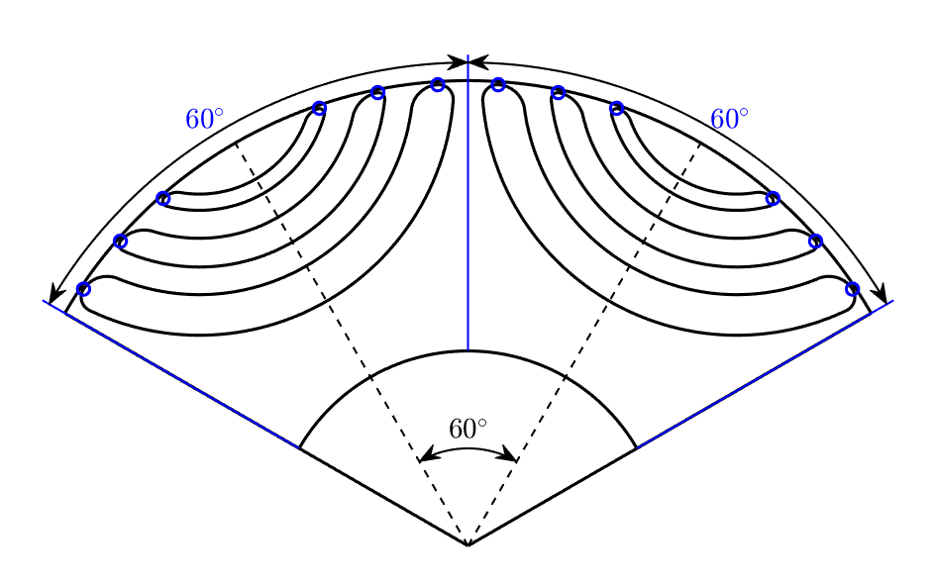
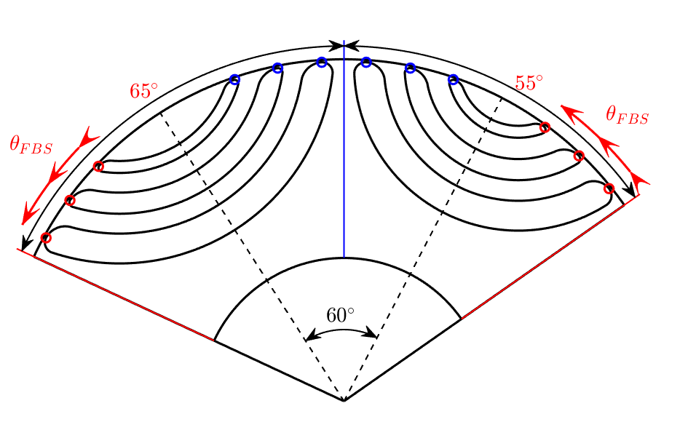
Flux Barrier Shift
Flux Barrier Shift (*) is used to reduce the torque ripple in SyR and PM-SyR machines
Feature introduced on May 2018
Available only for Circular and Seg geometries
On the electrical period, one pole is narrowed by the shift angle, while the other is widened by the same quantity
Regular rotor
Shifted rotor
(*) S. Ferrari, G. Pellegrino, M. Davoli and C. Bianchini, “Reduction of Torque Ripple in Synchronous Reluctance Machines through Flux Barrier Shift”, 2018 XXIII International Conference on Electrical Machines (ICEM), Alexandroupoli, Greece, September 3-6, 2018.

Slide 10
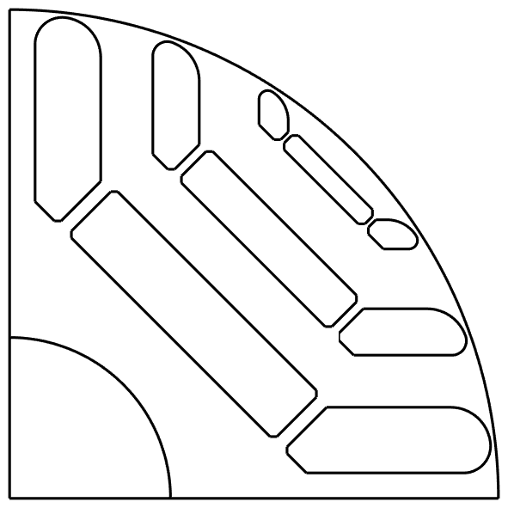
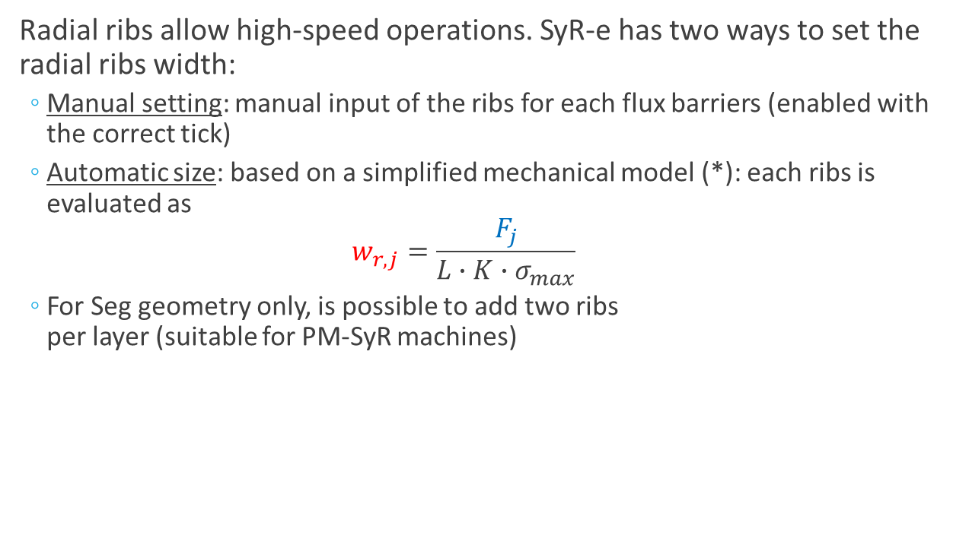
Mechanical model
Radial ribs allow high-speed operations. SyR-e has two ways to set the radial ribs width:
Manual setting: manual input of the ribs for each flux barriers (enabled with the correct tick)
Automatic size: based on a simplified mechanical model (*): each ribs is evaluated as $w_{r,j}=\frac{F_{j}}{L∙K∙σ_{max}}$
For Seg geometry only, is possible to add two ribs per layer (suitable for PM-SyR machines)
(*) M. Palmieri, M. Perta, F. Cupertino and G. Pellegrino, "High-speed scalability of synchronous reluctance machines considering different lamination materials," IECON 2014 - 40th Annual Conference of the IEEE Industrial Electronics Society, Dallas, TX, 2014, pp. 614-620.

Slide 11
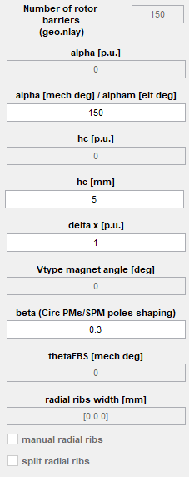
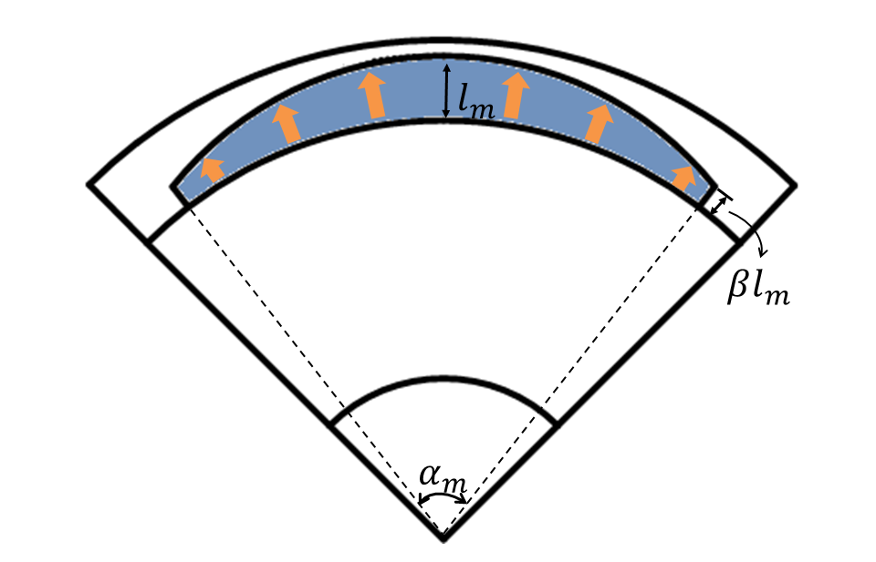
Rotor Parameter – SPM
(*) C. Lu, S. Ferrari, G. Pellegrino, C. Bianchini and M. Davoli, "Parametric design method for SPM machines including rounded PM shape," 2017 IEEE Energy Conversion Congress and Exposition (ECCE), Cincinnati, OH, 2017, pp. 4309-4315.

Slide 12
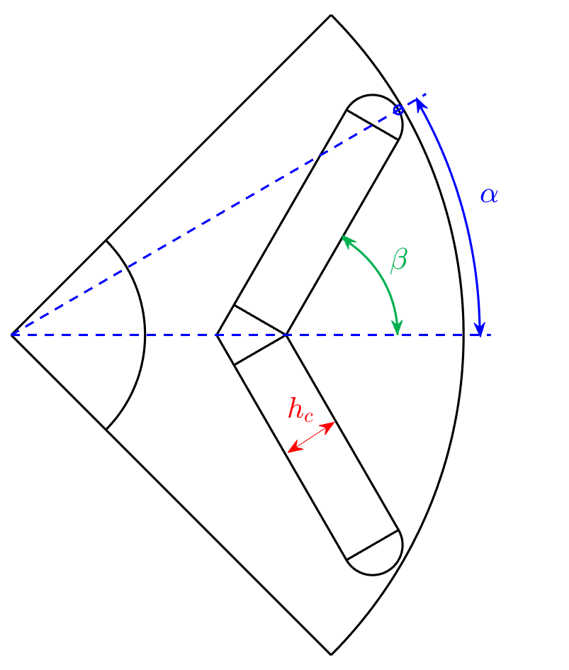
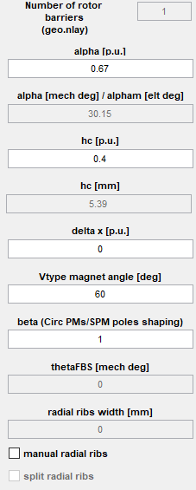
Rotor Parameter – Vtype
Structural ribs

Slide 13
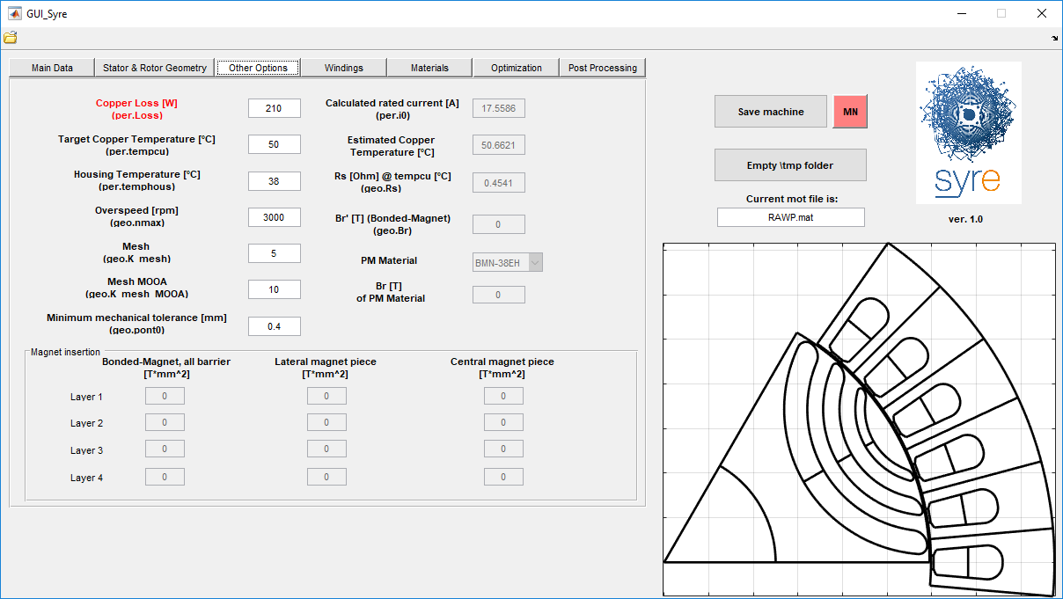
Additional inputs
Thermal model outputs
Maximum speed
Thermal model inputs
PM design (Seg)
Mechanical constraints
Mesh size in FEMM

Slide 14
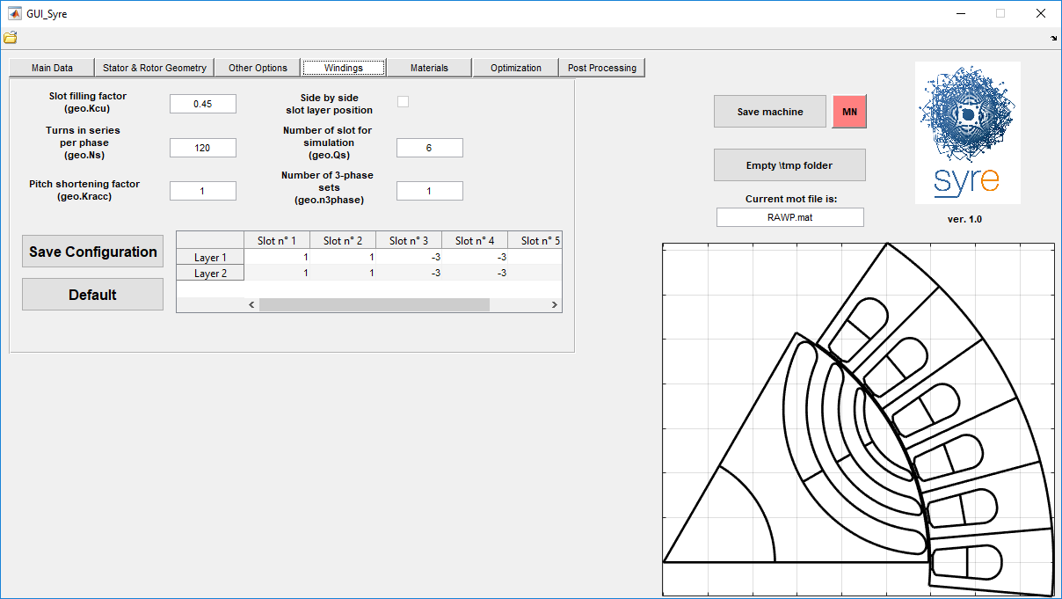
Windings setting
Number of slots in the FEMM model
Main winding parameters
Side-by-side layers (CW)
Winding scheme, computed with koil_syre (*)
Number of three-phase sets (for multiphase machines)
(*) koil_syre is a Matlab executable version of Koil (http://koil.sourceforge.net/)

Slide 15
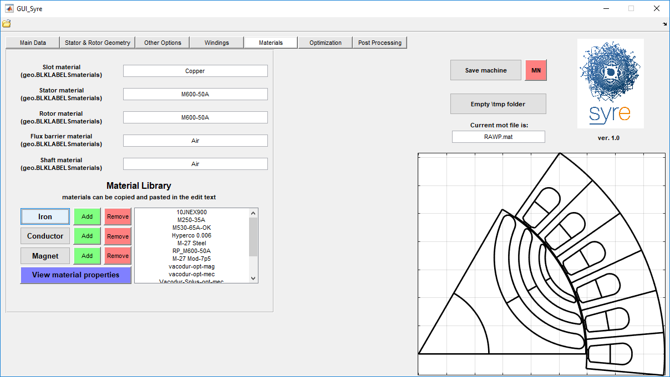
Material library
Machine groups
Material library, divided in 3 sections.
Is possible to add/remove custom material and view the properties of an existing material

Slide 16
Content
What is SyR-e?
SyR-e features
Preliminary Automatic Design
Design Optimization
FEA Evaluation/Validation
Case Study

Slide 17
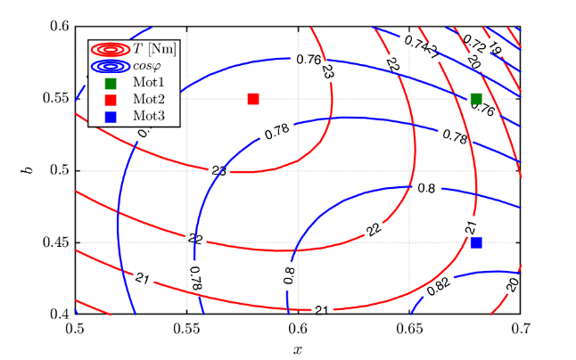
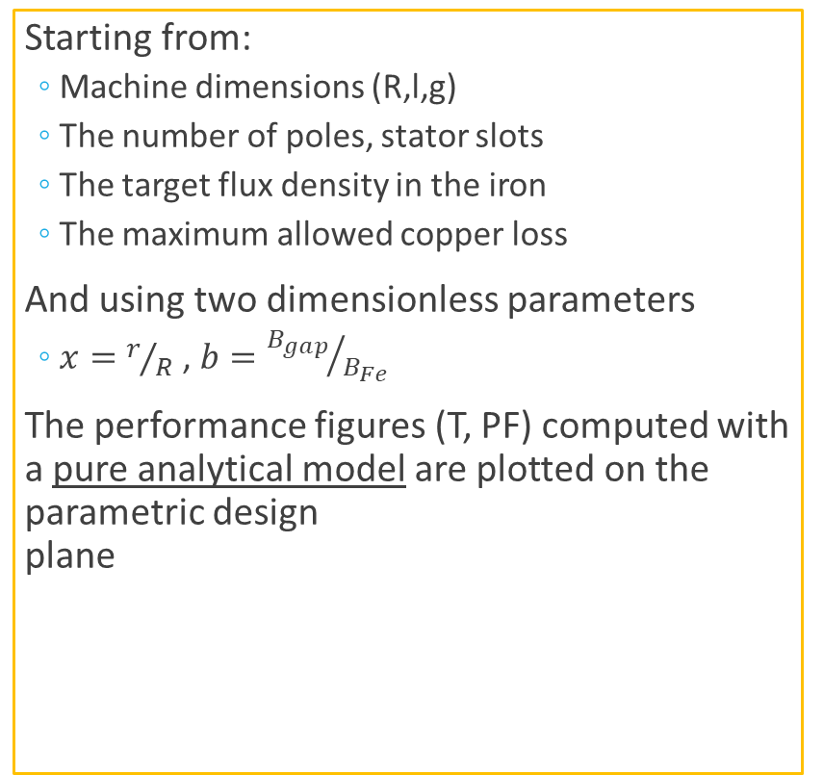
Preliminary Design
Starting from:
Machine dimensions (R,l,g)
The number of poles, stator slots
The target flux density in the iron
The maximum allowed copper loss
And using two dimensionless parameters
$x=r/R$ , $b={B_{gap}}/{B_{Fe}}$
The performance figures (T, PF) computed with a pure analytical model are plotted on the parametric design plane

Slide 18
FEA-Augmented Model (FEAfix)
FEA simulations of selected point on the design plane to correct the performance figure estimation
Slower and more precise than the pure analytical model
Parallel computing enabled for 4+ FEA
Selection of the number of points for FEA simulations:
1: center
4: corners
5: center + corners
1000: whole design domain (for debug only)
(*) S. Ferrari and G. Pellegrino, “FEA-Augmented Design Equations for Synchronous Reluctance Machines," 2018 IEEE Energy Conversion Congress and Exposition (ECCE), Portland, OR, September, 23-27 2018.

Slide 19
Content
What is SyR-e?
SyR-e features
Preliminary Automatic Design
Design Optimization
FEA Evaluation/Validation
Case Study

Slide 20
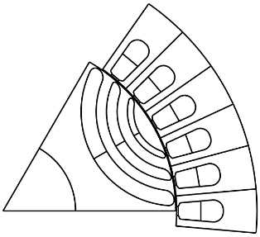
Design Optimization
SyR-e uses Multi-Objective Differential Evolution (MODE) algorithm to perform the design optimization
The candidate evaluation is performed in with FEA
Parallel computing enabled under MATLAB environment
Draw the candidate
Call FEMM
MODE
Fitness Evaluation
Selection
Mutation
Crossover

Slide 21
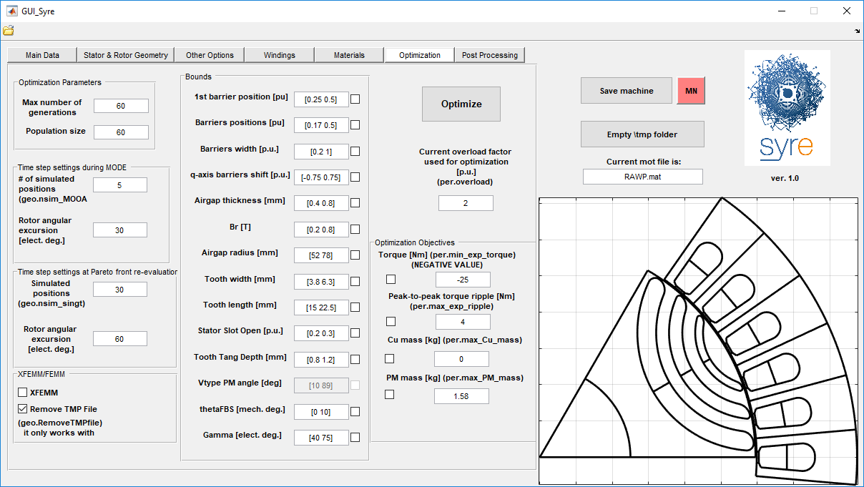
Multi-Objective Design Optimization
MODE settings
Optimization variables
Optimization objectives

Slide 22
Content
What is SyR-e?
SyR-e features
Preliminary Automatic Design
Design Optimization
FEA Evaluation/Validation
Case Study

Slide 23
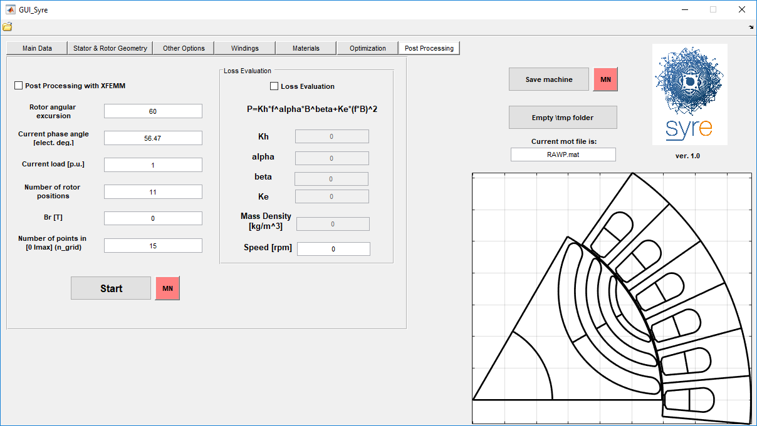
FEA simulations
Current angle in the dq frame.
If 1000: id-iq map
FEA simulation inputs
Iron loss computation with static FEA (work in progress)

Slide 24
Content
What is SyR-e?
SyR-e features
Preliminary automatic design
Design Optimization
FEA Evaluation/Validation
Case Study

Slide 25
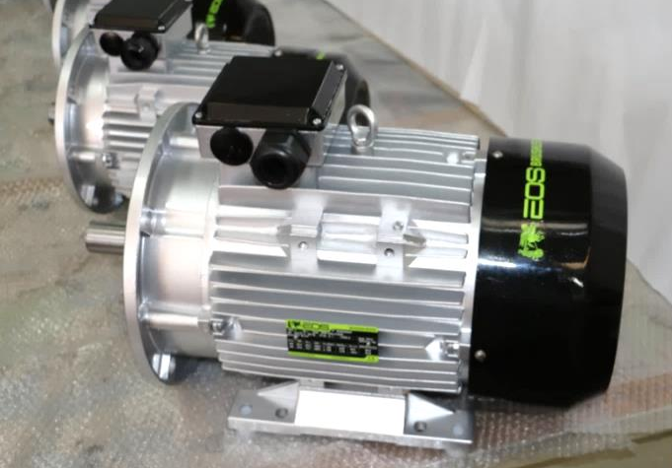

Case study
Objective:
Design a SyR rotor for an Induction Machine (IM) stator
Design steps:
Preliminary design
FEA post-processing
Flux Barrier Shift
Design Optimization
Design comparison

Slide 26
Design inputs
The main data of the baseline stator are (*):
Outer radius = 87,5 mm
Stack length = 110 mm
Number of pole pairs = 3
Number of stator slots = 36
Winding: single layer, 108 turns in series per phase,
Iron Material: M600-50A
In addition, some useful data from the baseline machine are:
Airgap length = 0,325 mm
Rated copper loss = 170 W
(*) C. Bianchini, M. Davoli, G. Pellegrino, F. Immovilli and E. Lorenzani, "Low cost PM synchronous servo-applications employing asynchronous-motor frame," 2015 IEEE Energy Conversion Congress and Exposition (ECCE), Montreal, QC, 2015, pp. 6090-6095.

Slide 27
Content
What is SyR-e?
SyR-e features
Preliminary automatic design
Design Optimization
FEA Evaluation/Validation
Case Study
Preliminary design
FEA post-processing
Flux Barrier Shift
Design optimization
Design comparison

Slide 28
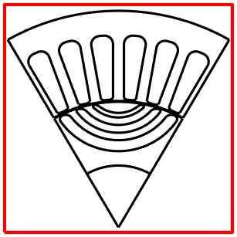
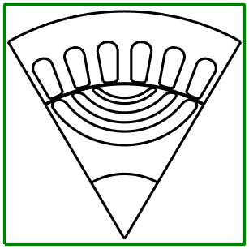
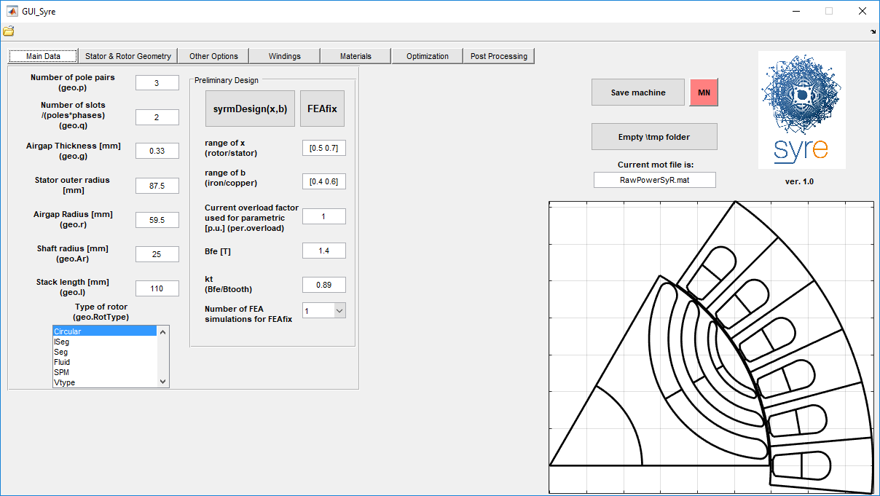
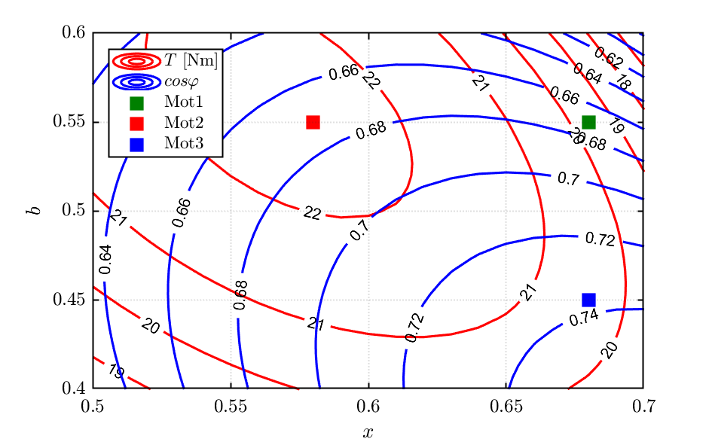
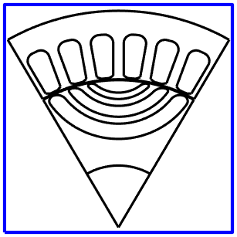
Preliminary design – analytical model

Slide 29
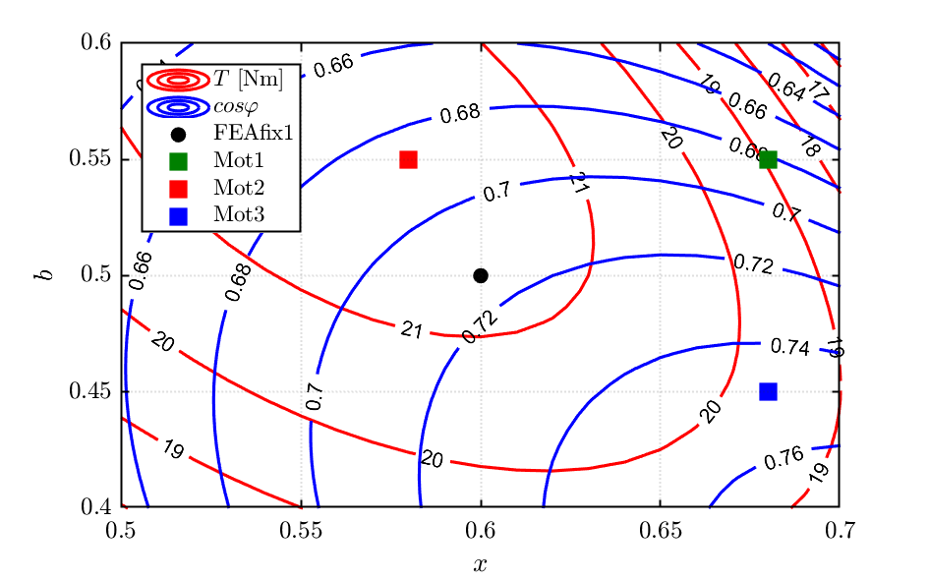
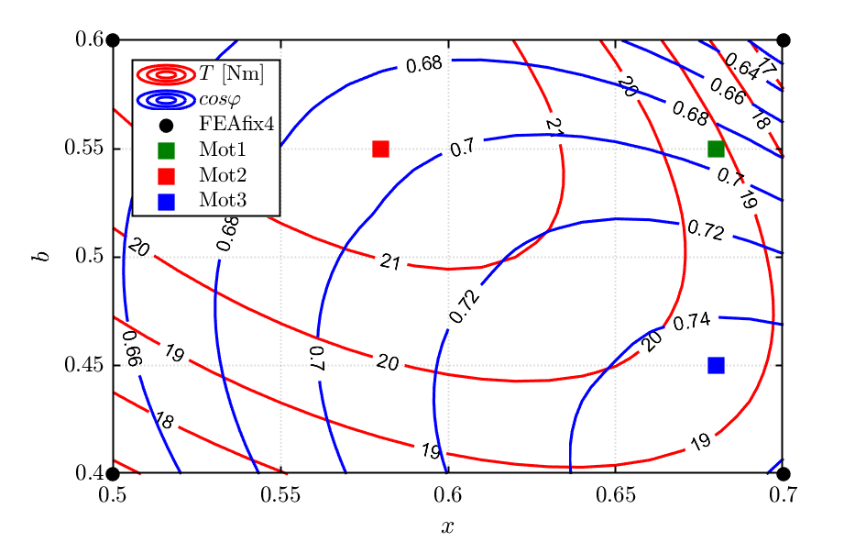
Preliminary design – FEAfix

Slide 30
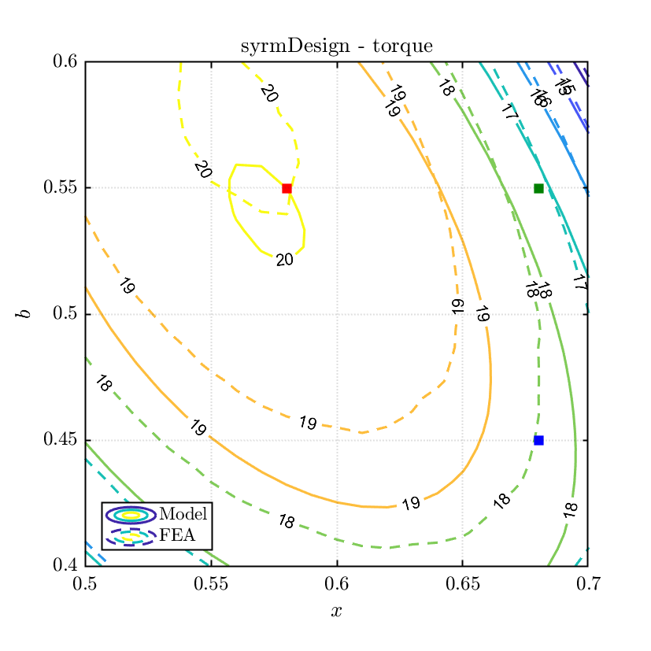
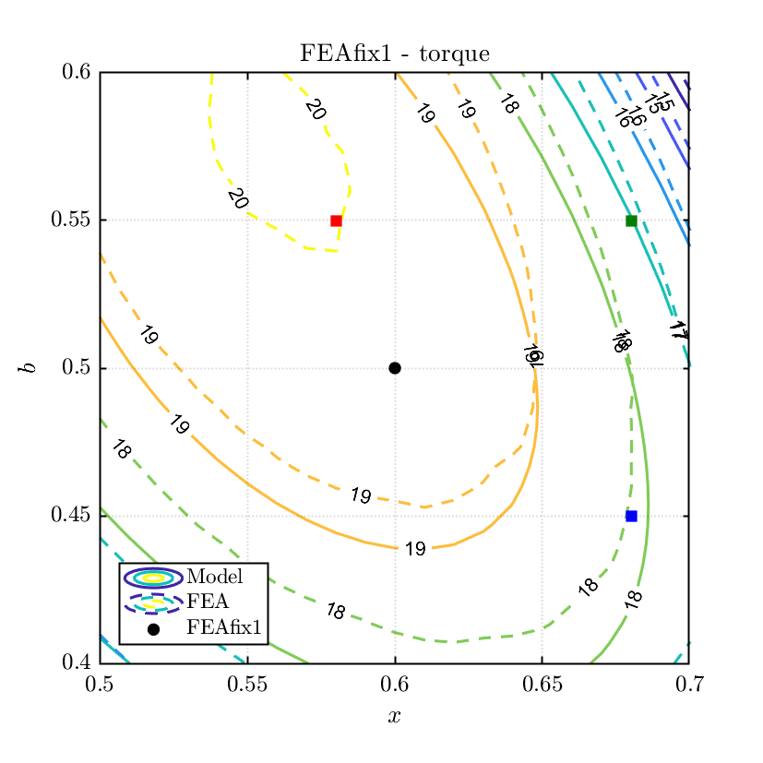
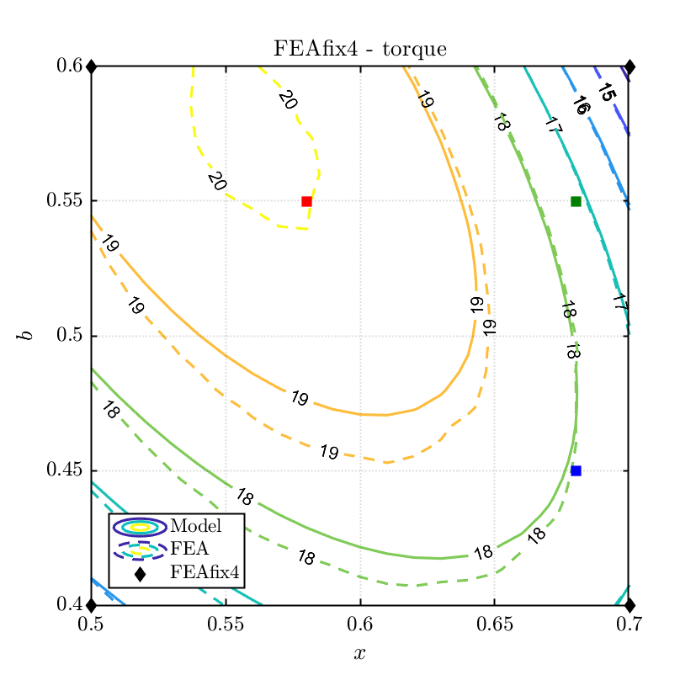
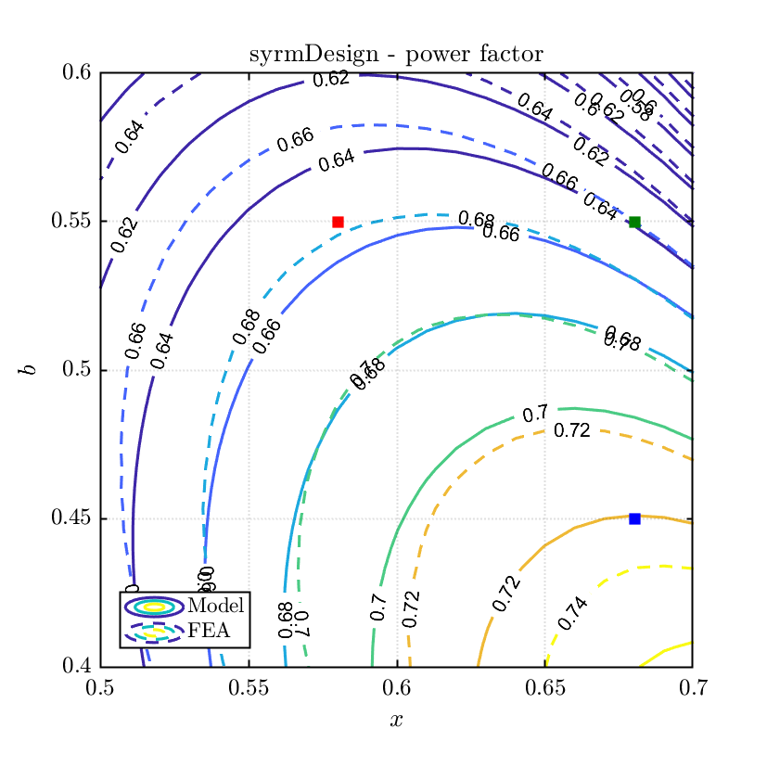
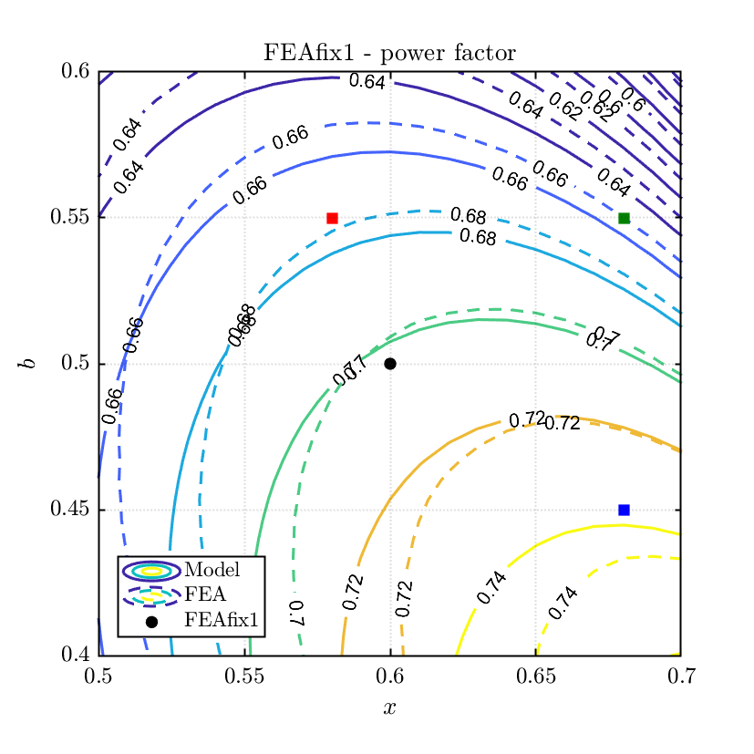
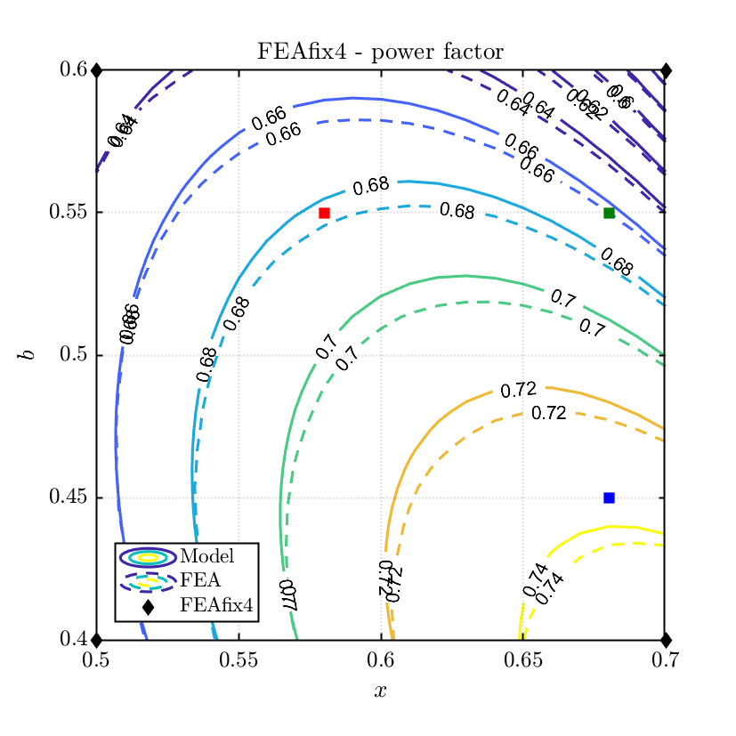
Preliminary design – FEA validation

Slide 31
Content
What is SyR-e?
SyR-e features
Preliminary automatic design
Design Optimization
FEA Evaluation/Validation
Case Study
Preliminary design
FEA post-processing
Flux Barrier Shift
Design optimization
Design comparison

Slide 32
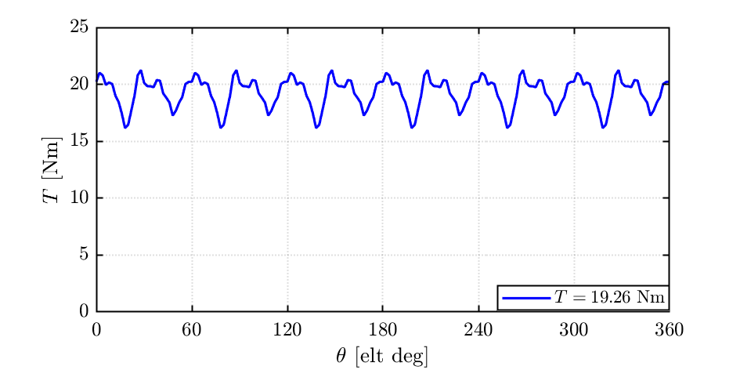

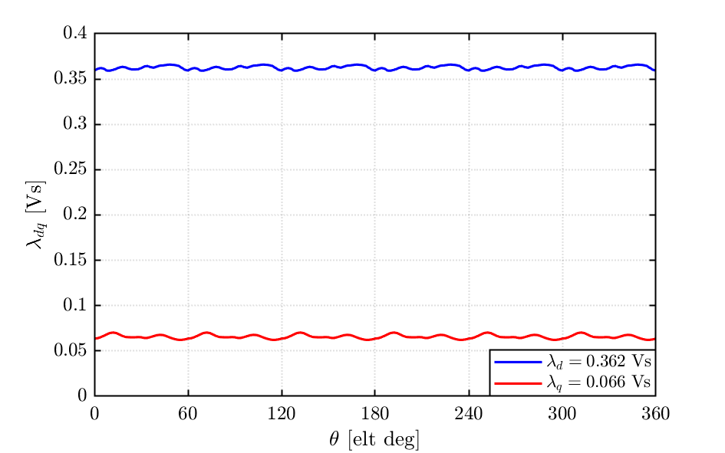
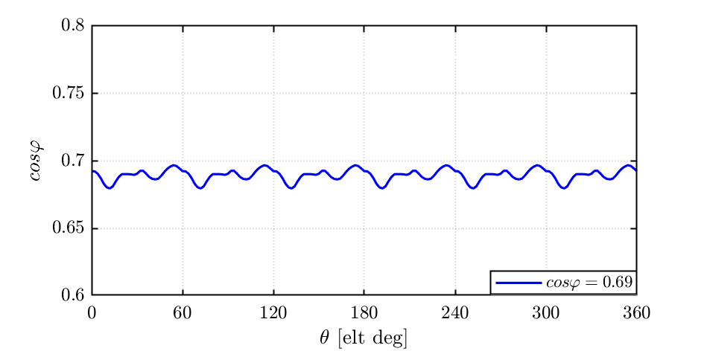
FEA post-processing – single point

Slide 33
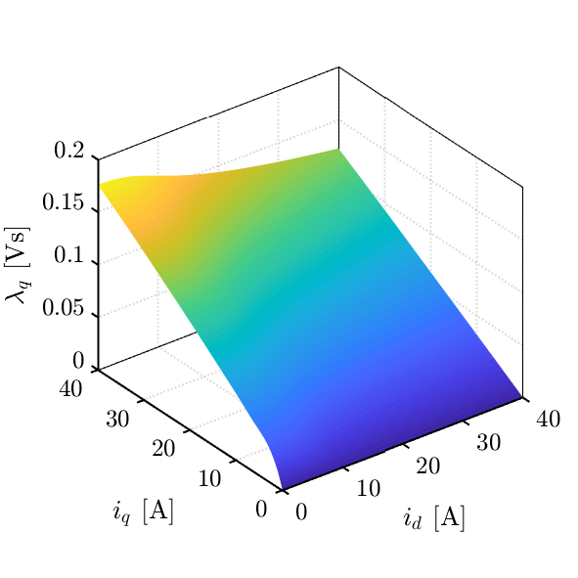
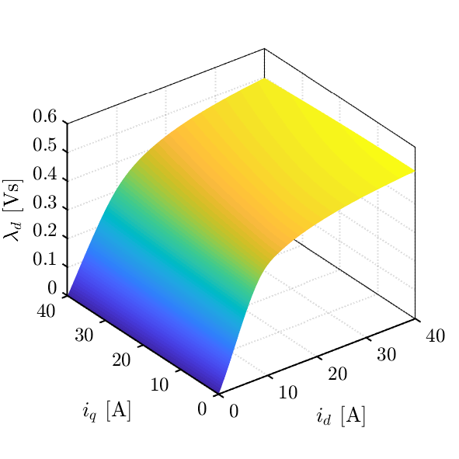

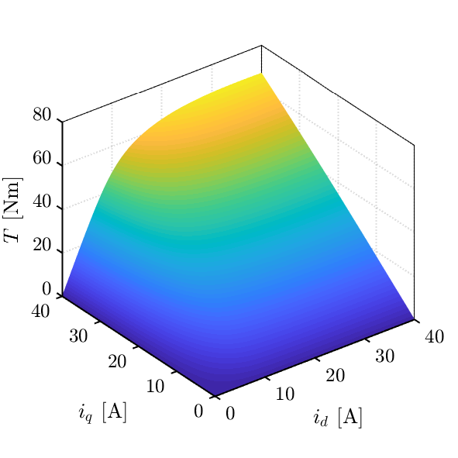
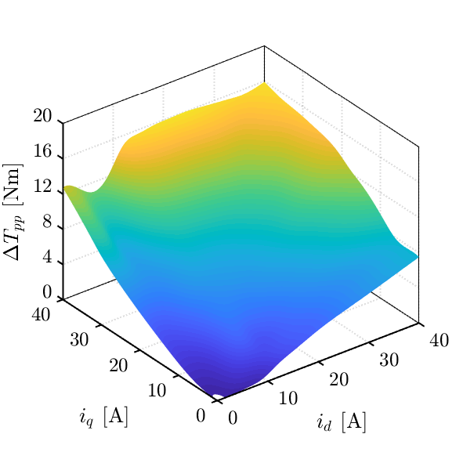
FEA post-processing – magnetic model

Slide 34















Magnetic model manipulation
Once the machine magnetic model is available, there are some functions (out of the GUI) for the manipulation of the data. They are:
C_MMLut.m
C_MtpaMtpvLut.m
C_torqueVSgamma.m
C_OperatingLimits.m
MaxTw.m

Slide 35
Content
What is SyR-e?
SyR-e features
Preliminary automatic design
Design Optimization
FEA Evaluation/Validation
Case Study
Preliminary design
FEA post-processing
Flux Barrier Shift
Design optimization
Design comparison

Slide 36








Flux Barrier Shift
$$θ_{FBS}=\frac{360}{2ph}$$

Slide 37
Content
What is SyR-e?
SyR-e features
Preliminary automatic design
Design Optimization
FEA Evaluation/Validation
Case Study
Preliminary design
FEA post-processing
Flux Barrier Shift
Design optimization
Design comparison

Slide 38

Design Optimization

Slide 39




Design Optimization
Evolution results
Evolution
Pareto front re-evaluation (fine)

Slide 40
Content
What is SyR-e?
SyR-e features
Preliminary automatic design
Design Optimization
FEA Evaluation/Validation
Case Study
Preliminary design
FEA post-processing
Flux Barrier Shift
Design optimization
Design comparison

Slide 41









Design Comparison – MTPA
Preliminary Design
FBS Design
MODE Design

Slide 42




Design Comparison – Torque waveform
Preliminary Design
FBS Design
MODE Design

Slide 43



Design Comparison – Torque ripple map
Preliminary Design
FBS Design
MODE Design

